Slide 1


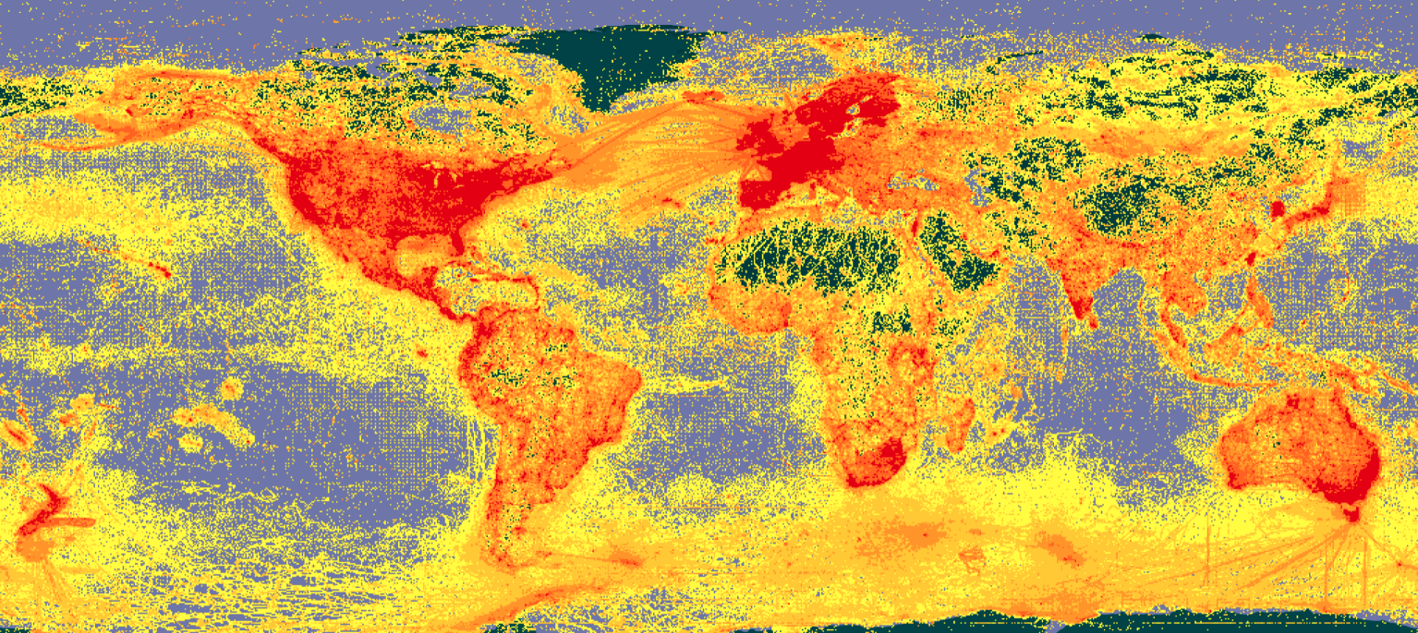
Big Data Ecology
Spatial Data
Christian König
Ecology and Macroecology Lab
Institute for Biochemistry and Biology
University of Potsdam
Source: www.gbif.org

Slide 2
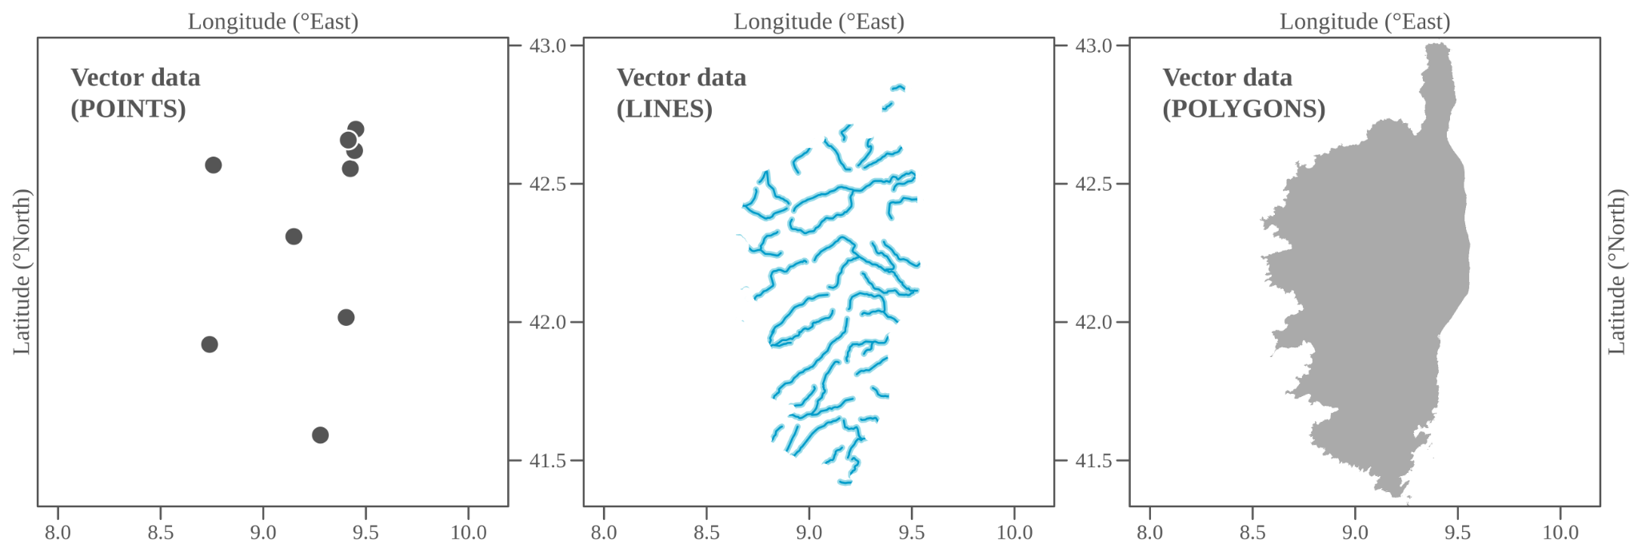
Vector data
Spatial features defined by vertices and paths
Attribute table may contain additional (non-spatial) information
Vector data types:
Source: https://insileco.github.io/IntroR

Slide 3
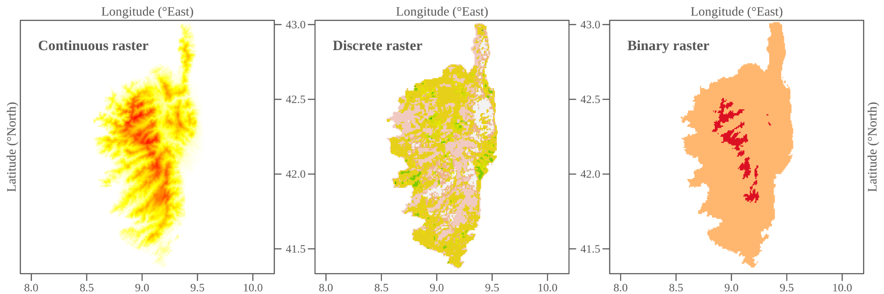
Raster data
Continuous spatial surfaces defined by a matrix/grid of values
Spatial extent and resolution
Raster value types:
Source: https://insileco.github.io/IntroR

Slide 4
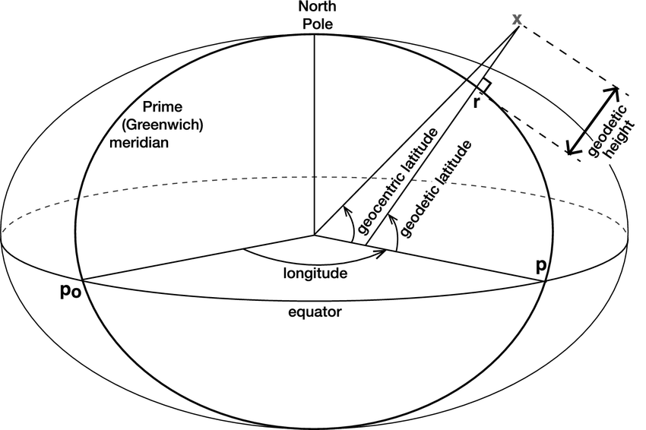
Coordinate Systems
Ellipse: Mathematical representation of the Earth as a geometrical object (radius, flattening).
Datum: Defines the position of the origin, the scale, and the orientation of the coordinate system relative to the Earth
Coordinates can be expressed in angular units relative to the equator and prime meridian of the reference ellipsoid
Source: Gregory et al. (2019) 10.1007/s10712-019-09525-z

Slide 5
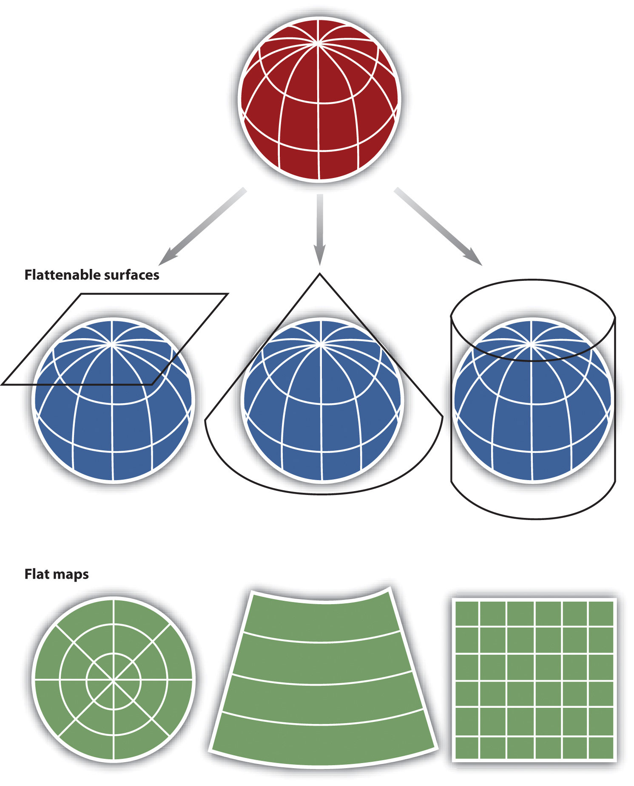
Projections
Projections map the coordinates from a 3D surface (as defined by the ellipsoid and reference datum) to a 2D plane
Different families: azimuthal, conical, cylindrical
Projections may preserve direction, area, or distances, but never all of them!
The true size of geographical entities may be not what you think it is
Source: https://www.blendspace.com/lessons/p45LnYc6Gx13DA/location-map-projections-and-types

Slide 6
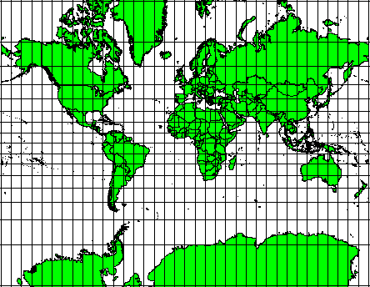
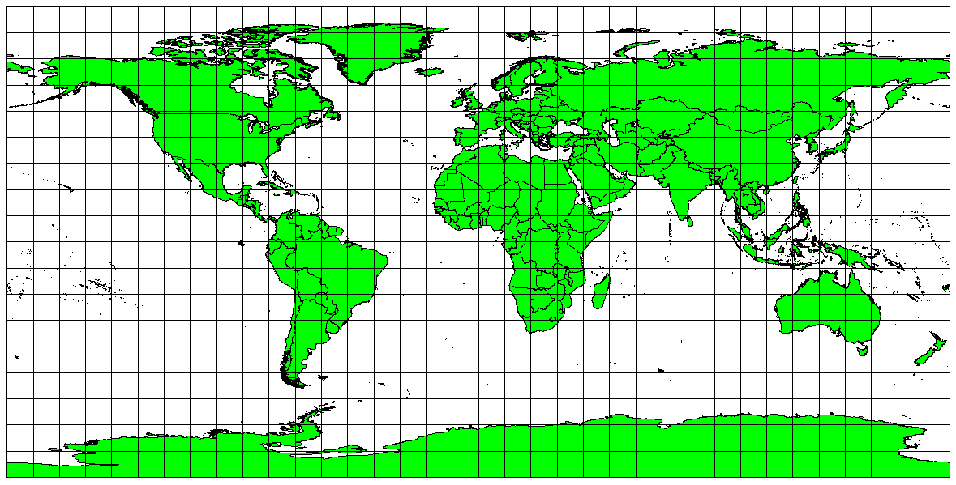
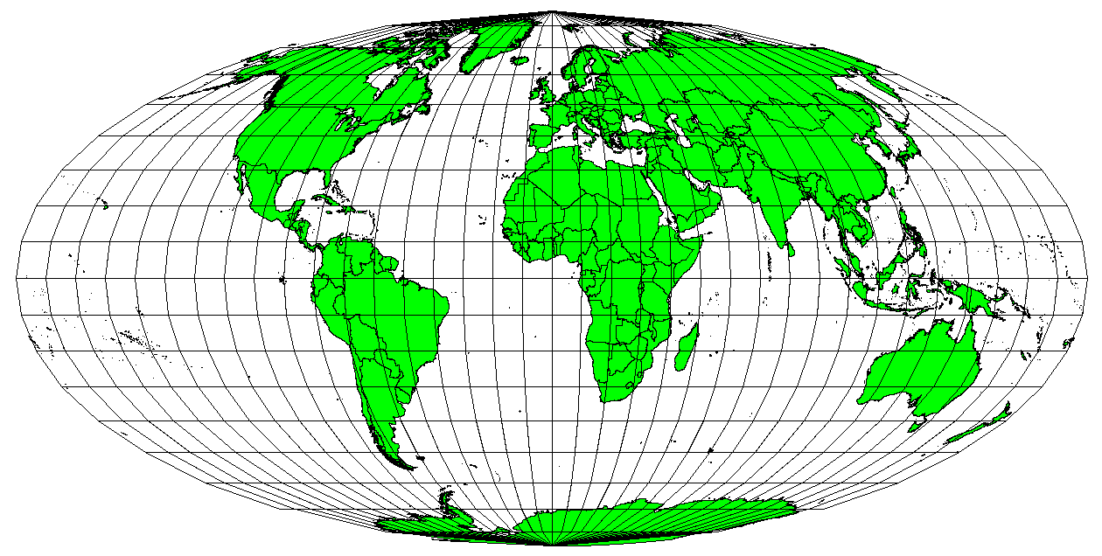
Projections
Conformal
preserves angles
Equidistant
preserves distances
Equal area
preserves area
Mercator projection
Plate Carrée equidistant cylindrical projection
Mollweide equal area cylindrical projection
Source: https://docs.qgis.org/3.16/en/docs/gentle_gis_introduction/coordinate_reference_systems.html

Slide 7
Coordinate Reference Systems (CRS)
The coordinate reference system holds all information relevant to represent geospatial data: reference ellipsoid, datum and projection
Different standards defining the CRS, e.g.:
EPSG code: four to five digit numeric code for widely used CRS’s, e.g. 4326 for lon/lat on WGS84 ellipsoid
Proj4 String: explicit definition of the CRS, e.g. ‘+proj=longlat +ellps=WGS84 +datum=WGS84 +no_defs’ lon/lat on WGS84 ellipsoid
WKT2: more modern and structured definition of the CRS, see e.g. here for the WKT2 definition of lon/lat on WGS84 ellipsoid

Slide 8
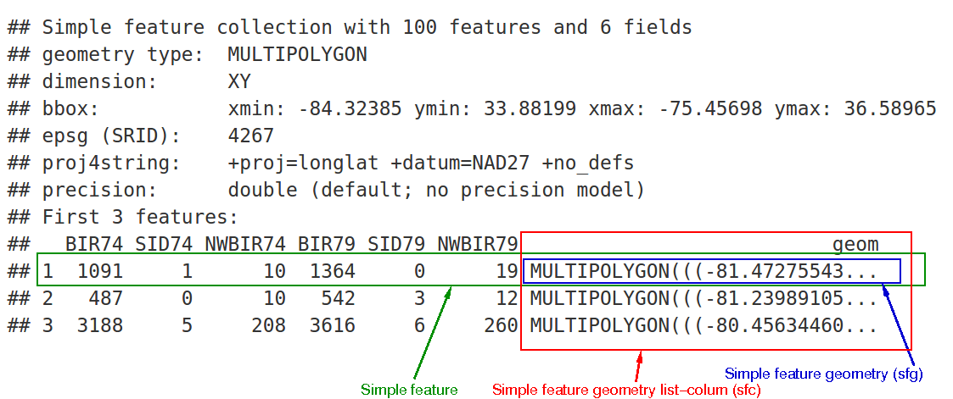
Spatial Data in R
Rich ecosystem of spatial R-packages
Vector Data:
sp - “classical” framework for spatial data in R
sf - modern implementation of simple features, supports dplyr syntax
Raster Data:
raster - standard, most widely used R-package for raster data manipulation
terra - more powerful, faster implementation of raster data formats in R
stars - recent project with focus on multidimensional arrays and integration with sf
There are countless packages for more specialized geospatial applications in R, e.g. for advanced data I/O, cartography, geostatistics, visualization, and more

Slide 9
Attribute data operations
Manipulate spatial (vector) data based on their attributes in much the same way as non-spatial data, e.g.:
Join information based on shared attributes/columns
Subset the dataset based on column values
Select or remove specific attributes/columns
Aggregate features based on their attributes/columns
...

Slide 10
Spatial data operations - vectors
Manipulate spatial (vector) data based on their spatial characteristics and relationships, rather than their attributes, e.g.:
Join information from different features based on their shared position
Subset the dataset based on topological relations with other features (e.g. intersection, adjacency)
Aggregate features based on their spatial grouping
...

Slide 11
Spatial data operations - rasters
Manipulate spatial raster data, e.g.:
Subset raster based on cell-IDs
use efficient map algebra algorithms, e.g. to perform arithmetic operations with multiple raster, reclassify values, calculate summary statistics or apply moving window approaches
Merge overlapping or neighbouring rasters

Slide 12
Geometry operations
Manipulation of spatial data based on their geometry, not their attributes/data, e.g.:
Dissolve boundaries of neighbouring polygon features
Crop spatial data to a different extent or clip it by another polygon features
Buffer vector data or calculate their centroid
Aggregate or Disaggregate raster data to a different resolution
Extract raster values for a given set of vector features

Slide 13
Practical
Work through the R practical spatial_data.md

Slide 14
Further readings
E-Books and tutorials:
https://saylordotorg.github.io/text_essentials-of-geographic-information-systems/index.html
https://docs.qgis.org/3.16/en/docs/gentle_gis_introduction
https://geocompr.robinlovelace.net/
https://r-spatial.github.io/sf/
Overview of spatial packages in R:
https://cran.r-project.org/web/views/Spatial.html
Coordinate Reference Systems:
https://www.nceas.ucsb.edu/sites/default/files/2020-04/OverviewCoordinateReferenceSystems.pdf
Cheatsheets:
https://github.com/rstudio/cheatsheets/blob/master/sf.pdf
https://www.maths.lancs.ac.uk/~rowlings/Teaching/UseR2012/cheatsheet.html

